Slide 1
Post-GWAS Analyses: A Whirlwind Overview
SMARTbiomed Summer School 2025
Dr Isabelle McGrath

Slide 2
GWAS Imputation
Why?
Increase overlap between GWAS summary statistics and LD reference
Improve density (important for fine-mapping)
ImpG-summary
https://github.com/bogdanlab/fizi
GWAS summary statistics + plink formatted data
GCTB --impute
https://cnsgenomics.com/software/gctb/#SBayesRCTutorial
GWAS summary statistics + eigen-decomposed data
Eigen-decomposed data from UKB for up to 13M imputed SNPs available to download (https://cnsgenomics.com/software/gctb/#Download)

Slide 3
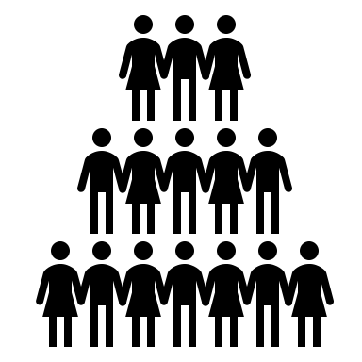

GWAS Summary Statistic Meta-Analysis
Advantages
Increase power without sharing individual level data
Identify heterogeneity across studies
Considerations
Phenotype definition
Fixed or random effect (do you expect the effects to be consistent across studies?)
Independence of samples
Quality control
Same Trait, Same Ancestry | Same Trait, Different Ancestries | Different Traits, Same Ancestry
METAL (Willer, 2010) GWAMA (Mägi, 2010) METASOFT (Han, 2011) | MANTRA (Morris, 2011) MR-MEGA (Mägi, 2017) | MTAG (Turley, 2018)

Slide 4
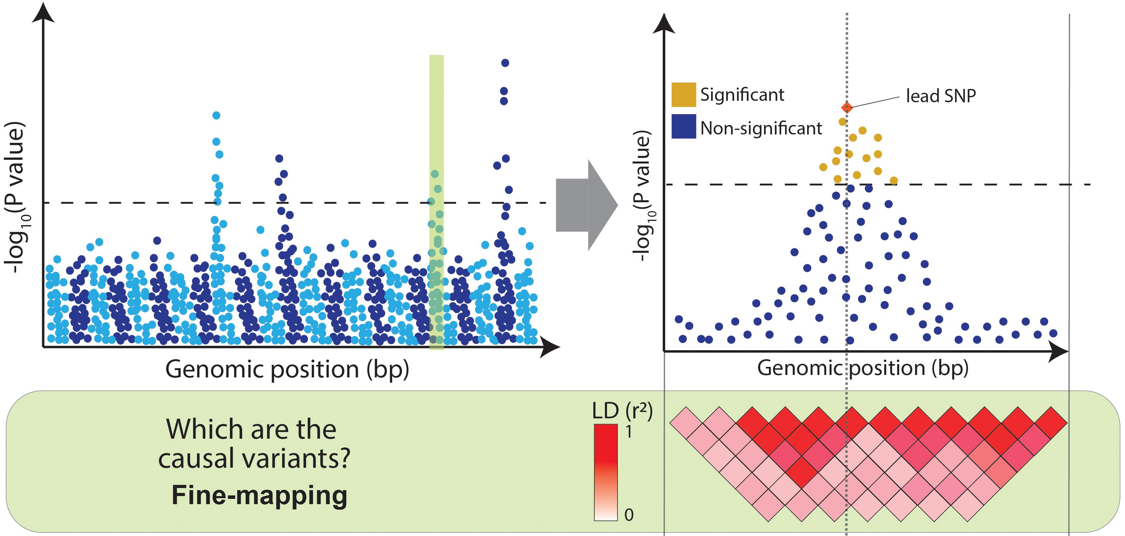
Fine-mapping
Cano-Gamez, 2020

Slide 5
Fine-mapping
Multiple causal variants
SuSiE (Wang, 2020)
CAVIAR (Hormodiari, 2014)
FINEMAP (Benner, 2016)
COJO-ABF (Yang, 2012)
Different assumptions of causal effect distribution
Why? Wrong assumptions can lead to miscalibration
SuSiE-Inf, FINEMAP-Inf (Cui, 2024)
Integrate functional data
Why? Biologically-informed
PolyFun (Wiessbrod 2020)
PAINTOR (Kichaev, 2020)
fastPAINTOR (Kichaev, 2017)
SuSiE² (Zhang, 2024)
Multiple tissues/cell-types
Why? Complex diseases have tissue-specific mechanisms
TGFM (Strober, 2025)
Multi ancestry
Why? Less LD, more samples
MESuSiE (Gao, 2024)
SuSiEx (Yuan, 2023)
MultiSuSiE (Rossen, 2024)
Genome-wide
Why? Considers global genetic architecture
GWFM (Wu, 2025)
& more!

Slide 6
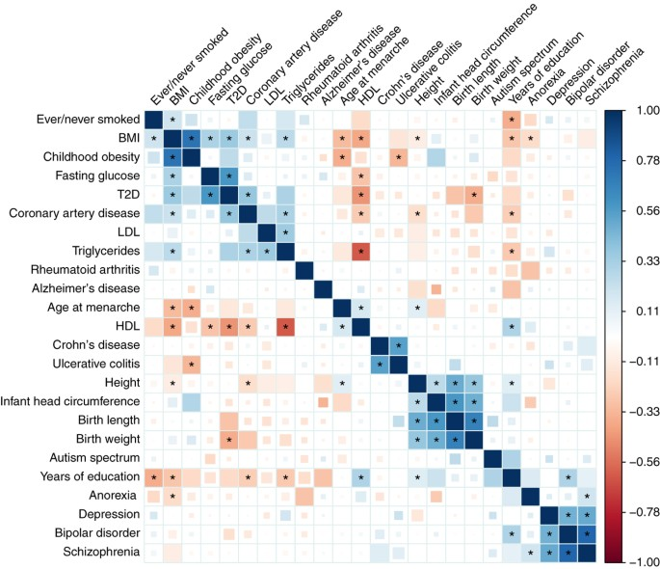
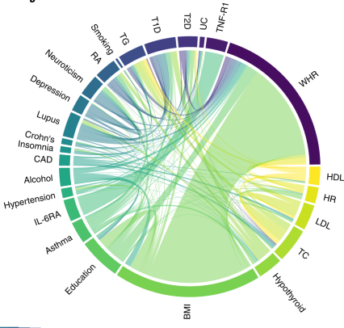
Genetic Correlation
Genome-wide
LDSC (Bulik-Sullivan, 2015)
Local
HDL-L (Li, 2025)
LAVA (Werme, 2022)

Slide 7
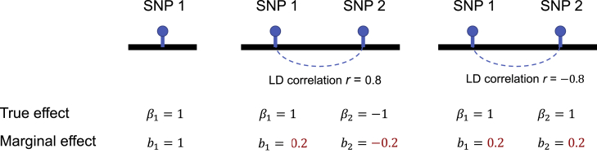
Gene-based analysis
(1) Assignment of GWAS SNPs to genes (usually by proximity)
(2) Test burden
Advantages
Common to observe multiple causal effects in a region
Reduce multiple testing burden
Input for downstream pathway analysis
mBAT-combo (Li, 2023) can handle masking effects:

Slide 8
Tissue/Cell Type Prioritisation
Epigenetics
Gene expression

Slide 9
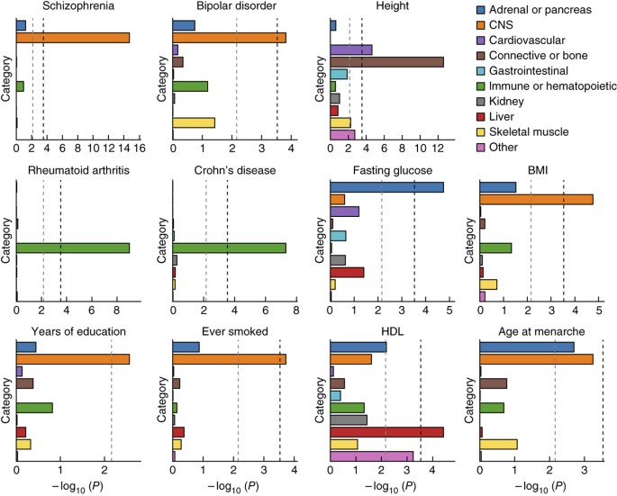
Partitioned Heritability
S-LDSC (Finucane, 2015)
Identifies enrichment of heritability with functional elements
Can inform relevant tissue/cell types

Slide 10
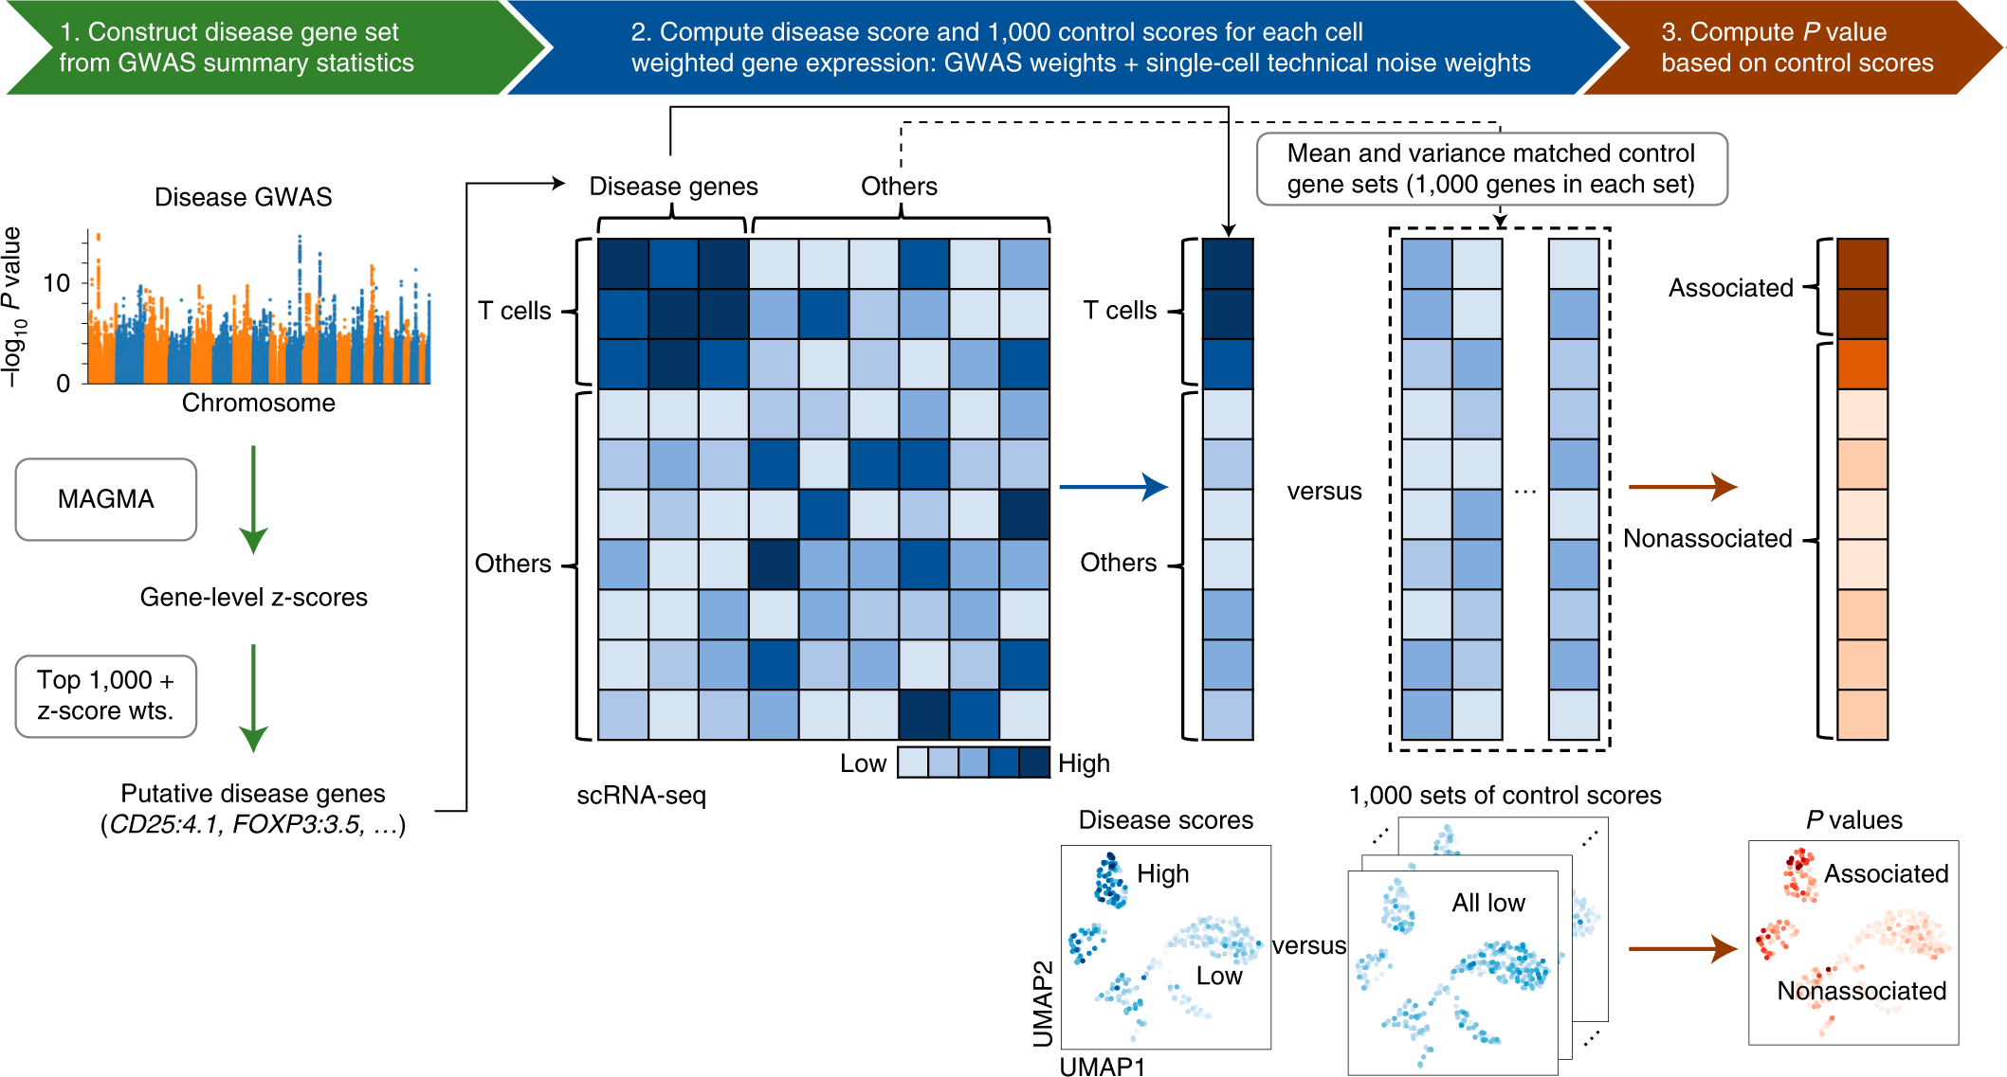
Single-cell Disease Relevance Score (scDRS)
Are GWAS genes excessively expressed in a particular cell type?

Slide 11
Causal Gene Prioritisation
Colocalisation
Transcriptome-wide association study (TWAS)

Slide 12
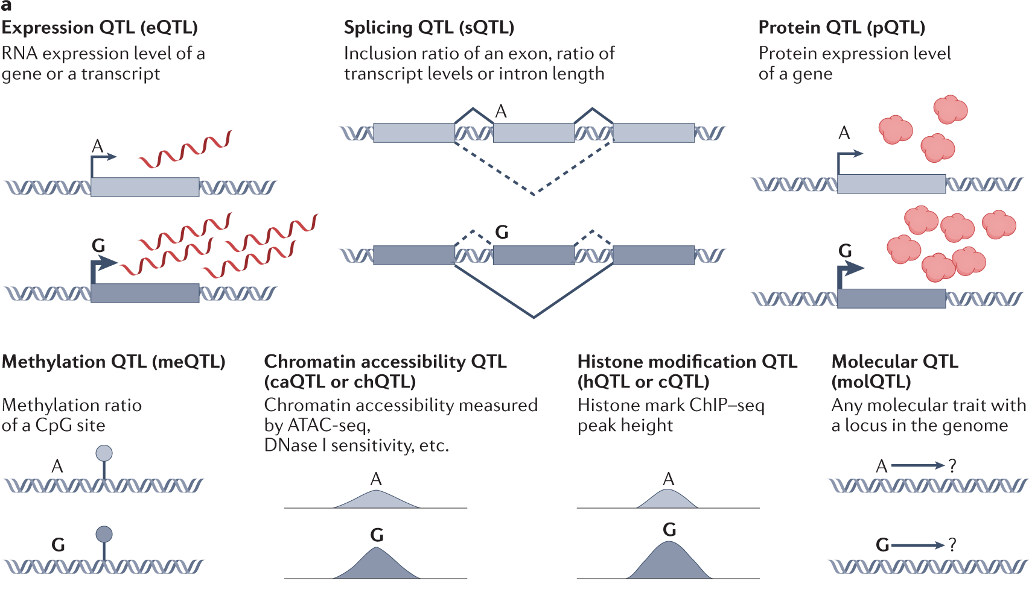
Molecular Quantitative Trait Loci (molQTLs)
cisQTL: variant affects a nearby molecular trait
transQTL: variant affects a distal molecular trait (e.g. a gene on another chromosome)
Aguet, 2023 & Brandt, 2017

Slide 13
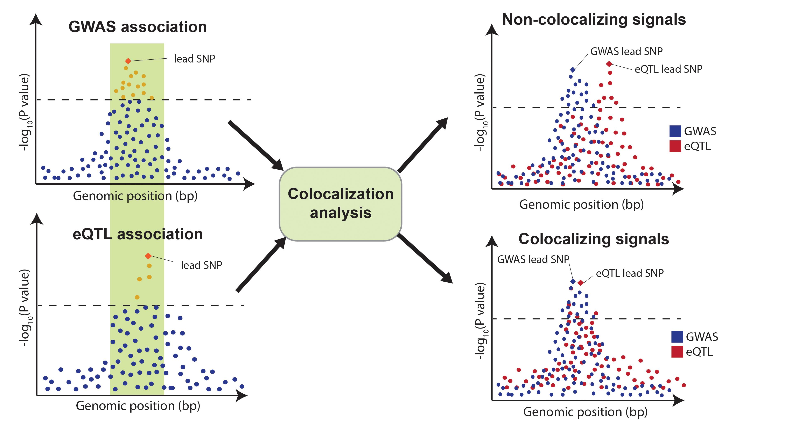
Colocalisation
Is the signal at a locus for trait A and trait B consistent with a shared causal variant?
COLOC (Giambartolomei, 2014)
Assumption: single causal variant
Integrate with SuSiE to allow multiple causal variants (Wallace, 2021)
H₀: no association with either trait in the region
H₁: association with trait 1 only
H₂: association with trait 2 only
H₃: both traits are associated, but have different single causal variants
H₄: both traits are associated and share the same single causal variant
Cano-Gamez, 2020

Slide 14
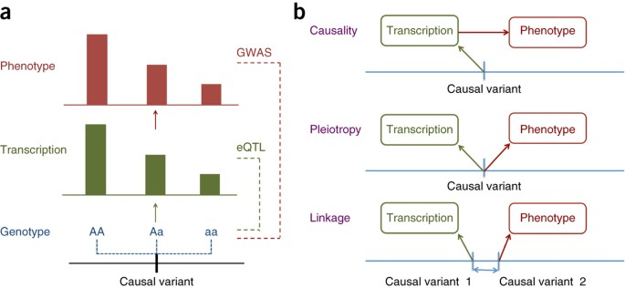
Summary-Mendelian Randomisation (SMR)
Leverage MR framework to identify genes whose expression levels are associated with a complex trait
Unable to distinguish between pleiotropy and causality
Output: association statistics for the effect of expression of the gene on the trait
HEIDI test to distinguish linkage from pleiotropy
Can also be considered a transcriptome-wide association study
eQTL: a variant that effects expression of a gene
(Zhu, 2016)

Slide 15
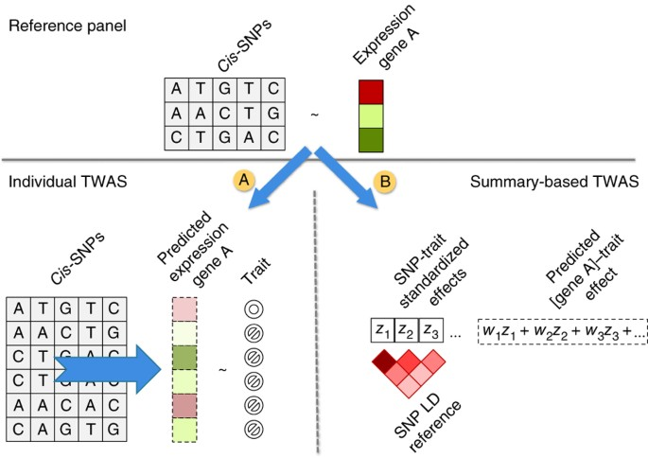
Transcriptome-Wide Association Study (TWAS)
Considerations
LD, gene expression correlation
eQTLs are often shared across cell types/tissues
eQTLs common in genome
Most methods require individual level reference panel to build gene expression model
Applications
“Causal” gene expression signature
A drug with an opposite gene expression signature may be effective in treating the condition
Many methods have been developed
FUSION, PrediXcan, SPrediXcan, ScPrediXcan, EXPRESSO, CONTENT, TESLA, SpliTWAS, GIFT, cTWAS…
Gusev, 2016

Slide 16
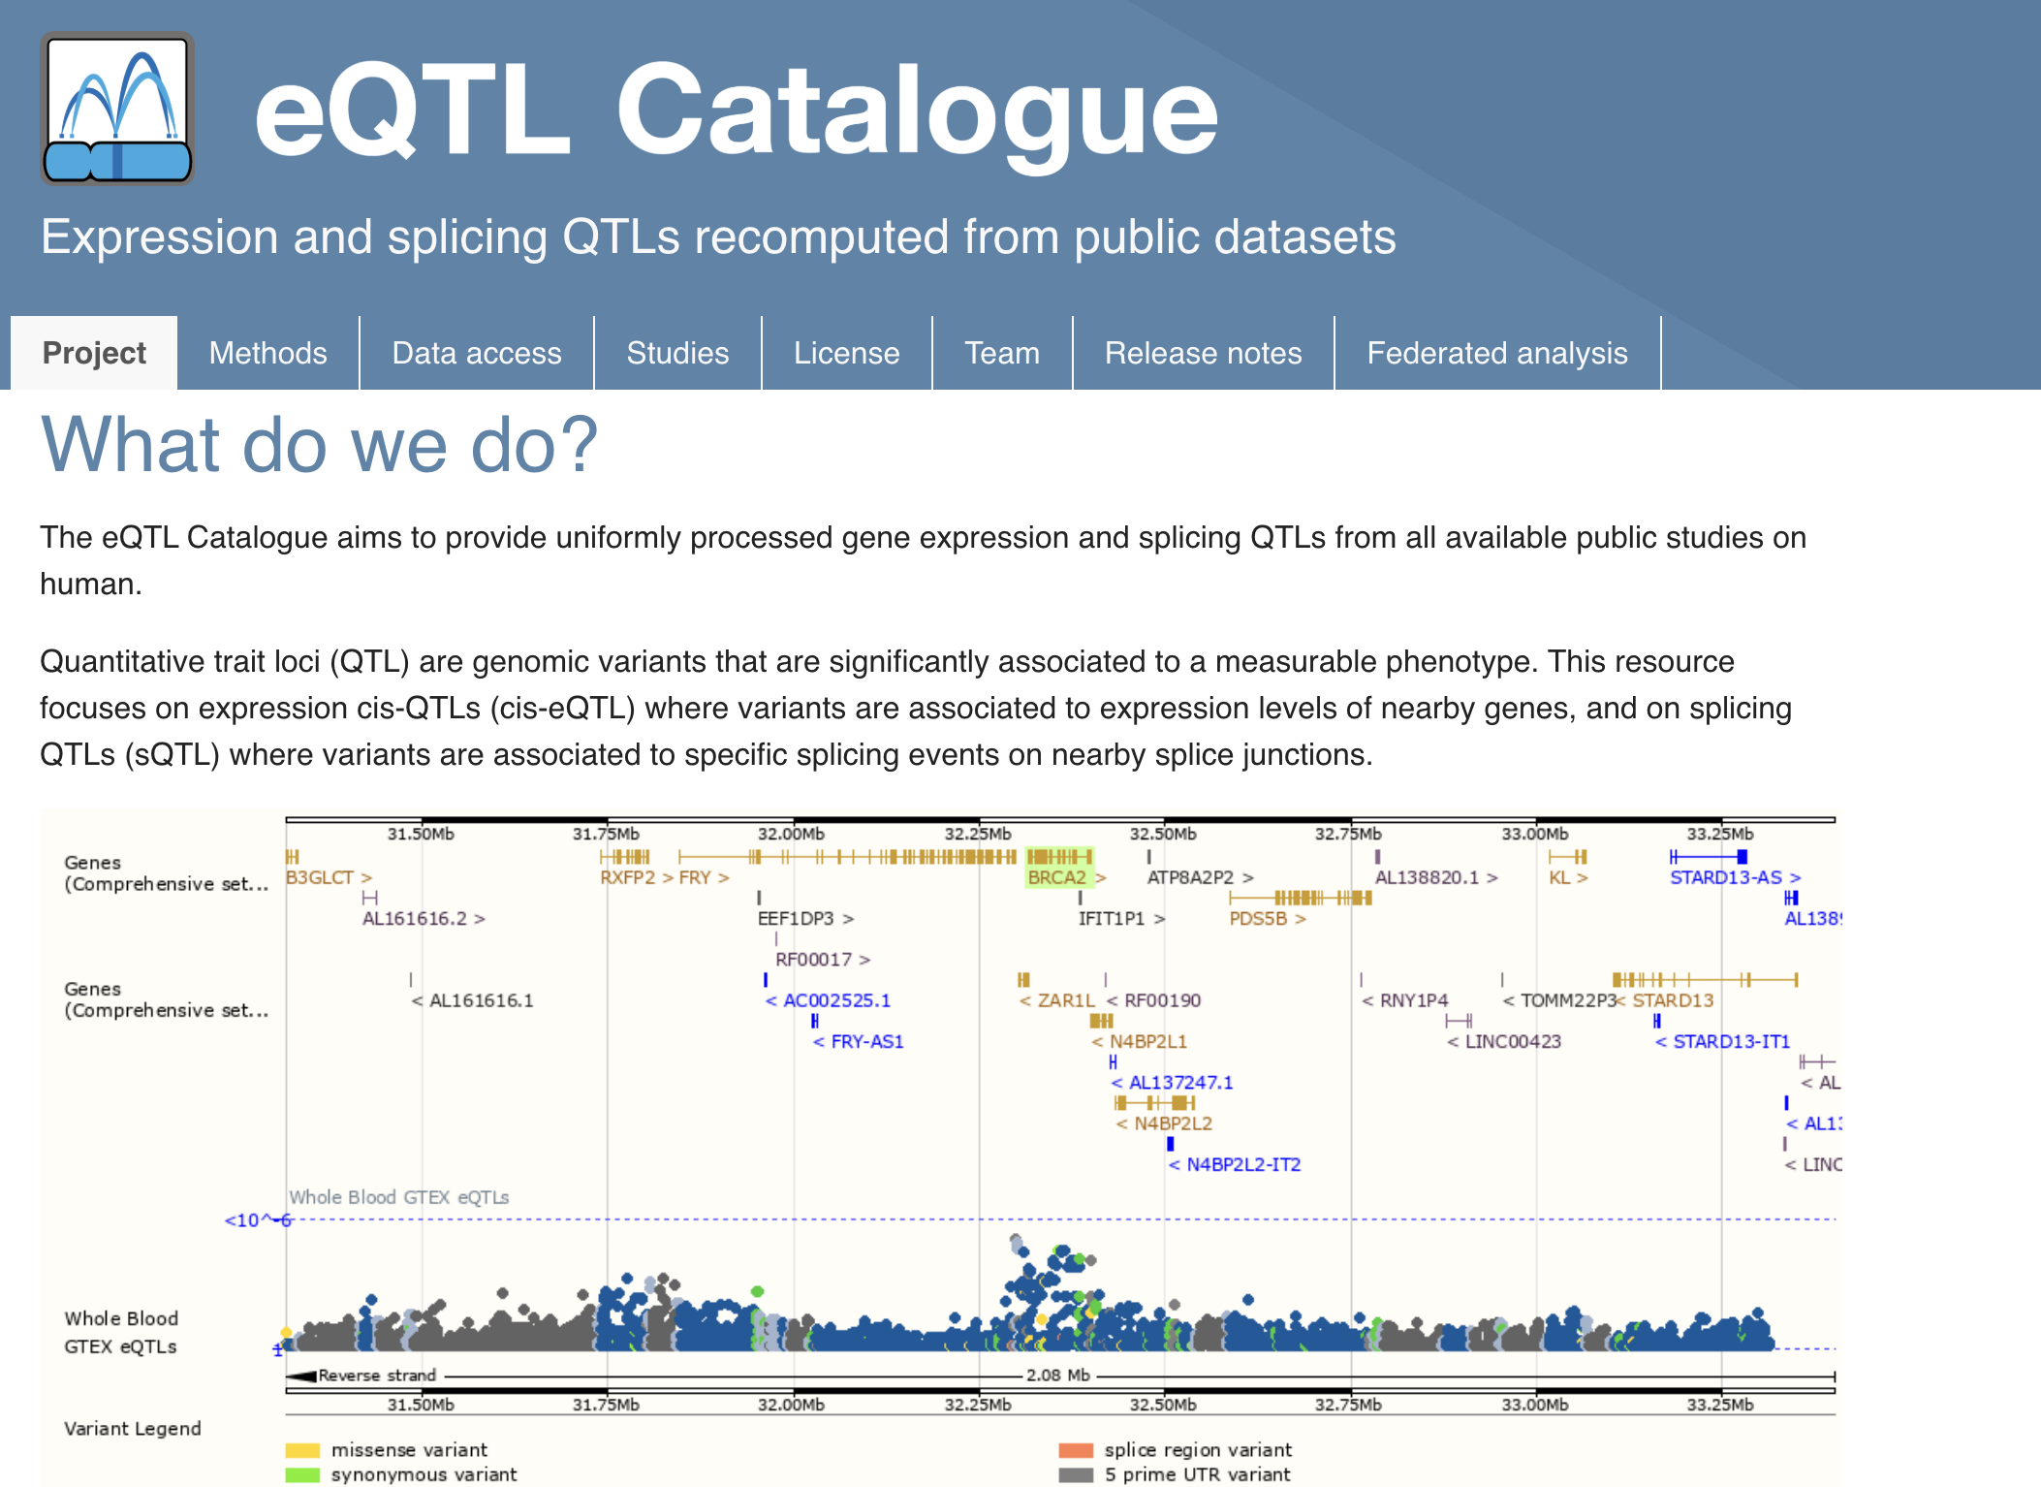
eQTL Catalogue
Studies included in the eQTL catalogue
Bulk RNA-seq
Single-cell RNA-seq
Protein QTL studies
Microarray studies

Slide 17
Final Remarks
We expect non-coding GWAS hits to have regulatory mechanisms, but many are not eQTLs
Power?
Trans-eQTLs?
Context?
Cell-type?
Cell-state?
Development stage?
Sex-specific?
Timely (Time of day, menstrual cycle-stage)?

Slide 18
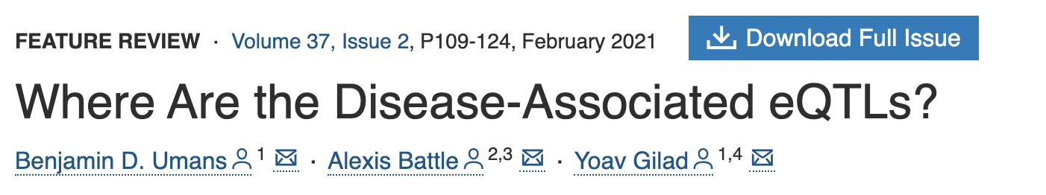
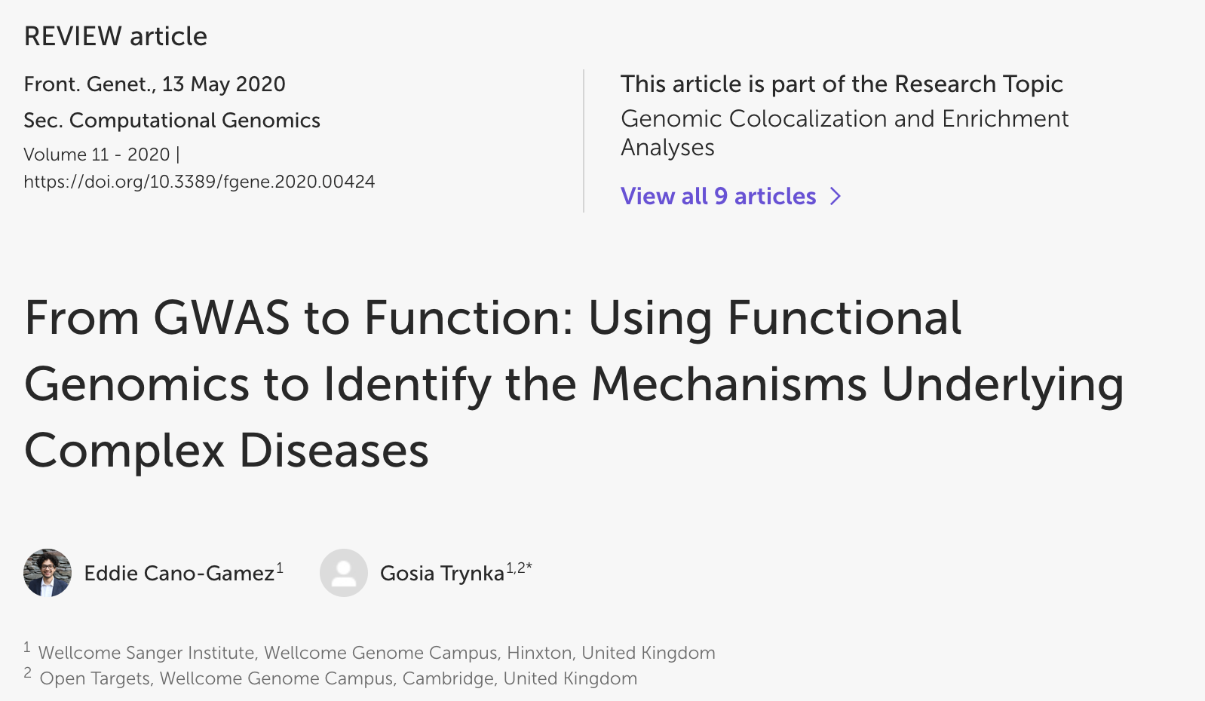
Recommended Reading

